Slide 1
Managing and Tracking the Software Project
Not every group is a team, and not every team is effective. Glenn Parker
If you want to be incrementally better: Be competitive. If you want to be exponentially better: Be cooperative

Slide 2
Questions from a Customer
Do you understand my problem and needs?
Can you design a system to solve my problems or satisfy my needs?
How long will it take to develop the system?
How much will it cost to develop the system?

Slide 3
Project Planning Principles
Understand the scope of the project
Involve the customer in the planning activity
Recognize that planning is iterative
Estimate based on what you know
Consider risk as you define the plan
Be realistic
Adjust granularity
Define how you intend to ensure quality

Slide 4
Project Planning
Before starting
Establish system’s scope and objectives
Consider alternative solutions
Identify technical and management constraints
As a Project Manager
Decompose the product function (FD)
Select an appropriate process model
Select the task set for the project
Decompose the tasks into smaller work items (WBS)
Estimate effort for each task/work item
Estimate completion time of the project (Task/Activity Network)

Slide 5
Word Processing Product
Consider a project that will build a new word-processing product:
Among the unique features of the product are:
continuous voice as well as keyboard input
extremely sophisticated “automatic copy edit” features
page layout capability
automatic indexing and table of contents, and others.
The project manager must first:
establish a statement of scope that bounds these features (as well as other more mundane functions such as editing, file management, document production, and the like).
For example, will continuous voice input require that the product be “trained” by the user? Specifically, what capabilities will the copy edit feature provide? Just how sophisticated will the page layout capability be? etc.

Slide 6
Task set example
Communications tasks
Develop list of clarification issues
Meet with customer to address clarification issues
Jointly develop a statement of scope
Review the statement of scope with all concerned
Modify the statement of scope as required
Planning/Construction
Understand the required technology
Learn the new domain/language
Modeling
Develop the architecture of the system under development

Slide 7
Factors Affecting Choice of Task Set
Size of project
Number of potential users
Mission criticality
Application longevity
Stability of requirements
Ease of communication (customer/developer)
Maturity of applicable technology
Performance constraints
Embedded/Non Embedded characteristics of project
Staff…

Slide 8
Project Schedule
Describes the software-development cycle for a particular project by
enumerating the phases or stages of the project
breaking each phase into discrete tasks or activities to be completed
Portrays the interactions among the activities and estimates the times that each task or activity will take

Slide 9
Project Schedule (Contd.)
Activity: takes place over a period of time
Predecessor activity
Milestone: completion of an activity or a set of activities -- a particular point in time
Precursor: event or set of events that must occur in order for an activity to start
Duration: length of time needed to complete an activity
Due date: date by which an activity must be completed

Slide 10
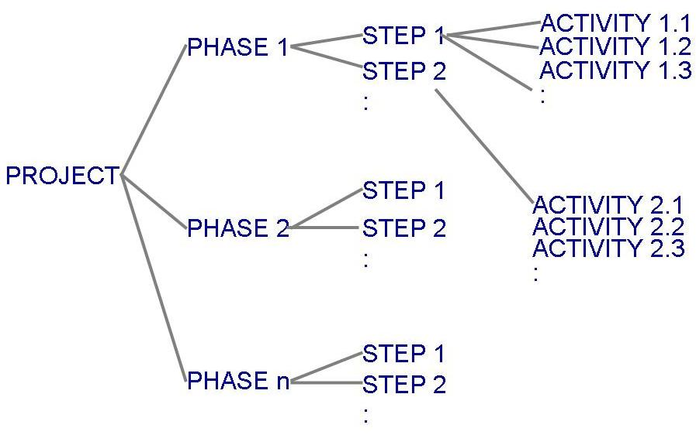
Project Schedule (Contd.)
Project development can be separated into a succession of phases which are composed of steps, which are composed of activities (Work Breakdown Structure)

Slide 11
WBS Example

Slide 12
WBS and Activity Networks
Work breakdown structure depicts the project as a set of discrete pieces of work
Activity networks (task network, PERT charts) depict the dependencies among activities
Activity networks can be of two types
AoA: Activity on Arc
AoN: Activity on Node

Slide 13
Project Types
Concept Development
To explore new business concept
New Application Development
As a consequence of specific customer request
Application Enhancement
Modifications to existing functions, performance, interfaces of software; observable by the end user
Application Maintenance
Correct, adapt, extend existing software; not immediately obvious to end user
Reengineering Projects
Redevelop an existing system

Slide 14
Concept Development Projects
Usually initiated to explore some new business concept or application of some new technology
Task set might be like:
Scope the concept
Develop preliminary plan of the concept: develop the ability to undertake the work
Assess the technology risk
Develop proof of concept
Implement the concept
Get customer feedback

Slide 15
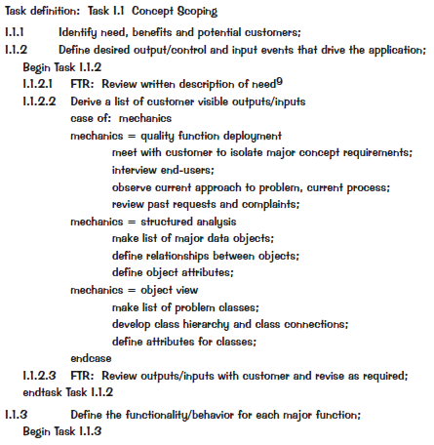
WBS for CDP

Slide 16
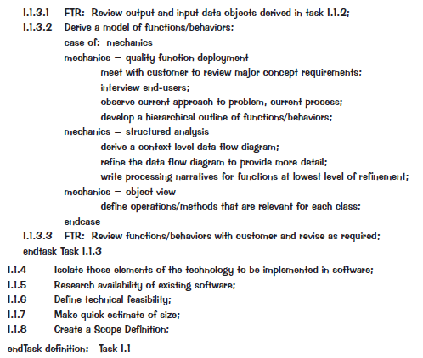
WBS for CDP (Contd.)

Slide 17
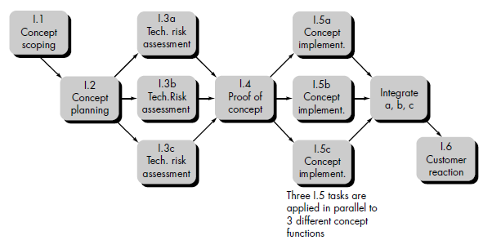
Activity Network for CDP
5
13
8
10
15
5
5
3
10
7
10
Activity on Node (AoN) Graph

Slide 18
Estimating Completion Critical Path Method
Minimum amount of time required to complete a project
Reveals those activities that are most critical to completing the project on time
Real time (actual time): estimated amount of time required for the activity to be completed
Available time: amount of time available in the schedule for the activity's completion
Slack time: the difference between the available time and the real time for that activity

Slide 19
Estimating Completion Critical Path Method
Critical path: the slack at every activity is zero
can be more than one in a project schedule
Slack time =
available time – real time
latest start time – earliest start time
Paths????
Longest Path???

Slide 20
Exercise
B
 | 30
C
 | 10
A
 | 20
G
 | 40
H
 | 10
E
 | 20
F
 | 40
D
 | 30

Slide 21
Exercise
B
 | 30
C
 | 10
A
 | 20
G
 | 40
H
 | 10
E
 | 20
F
 | 40
D
 | 30

Slide 22
Exercise (Contd.)
21 | 20 | 50
B
41 | 30 | 70
21 | 20 | 50
B
41 | 30 | 70
71 | 10 | 80
C
81 | 10 | 90
1 |  | 20
A
1 | 20 | 20
21 | 0 | 60
G
21 | 40 | 60
61 | 0 | 70
H
61 | 10 | 70
71 | 0 | 90
E
71 | 20 | 90
91 | 0 | 130
F
91 | 40 | 130
21 | 40 | 50
D
61 | 30 | 90

Slide 23
Exercise (Contd.)
21 | 30 | 50
B
51 | 30 | 80
71 | 10 | 80
C
81 | 10 | 90
1 | 0 | 20
A
1 | 20 | 20
21 | 0 | 60
G
21 | 40 | 60
61 | 0 | 70
H
61 | 10 | 70
71 | 0 | 90
E
71 | 20 | 90
91 | 0 | 130
F
91 | 40 | 130
21 | 40 | 50
D
61 | 30 | 90

Slide 24
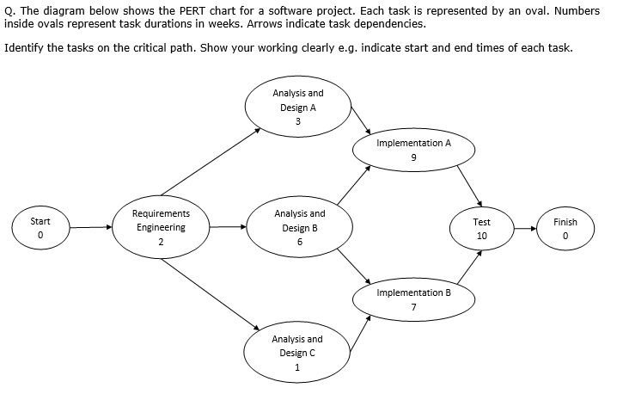
Exercise

Slide 25
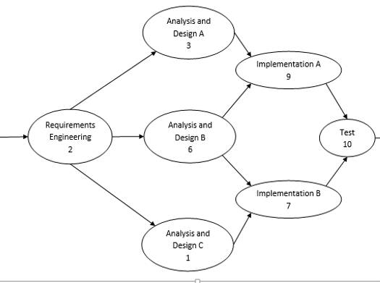

Slide 26
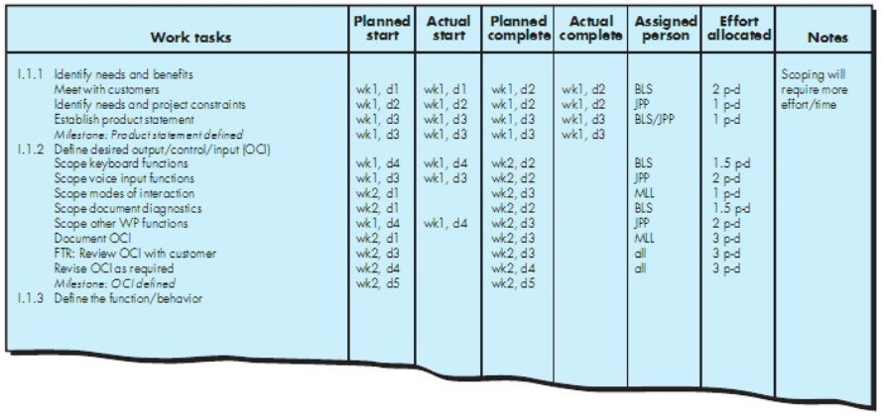
Project Table

Slide 27
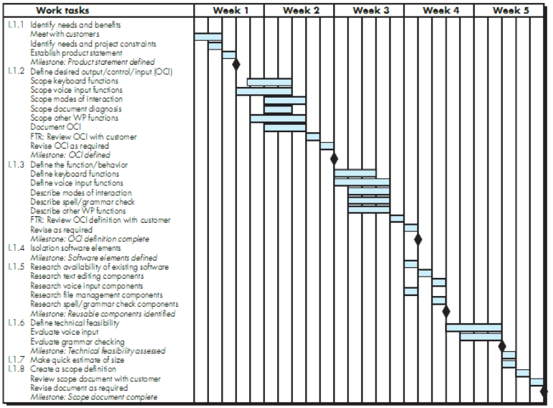
Gantt Chart

Slide 28
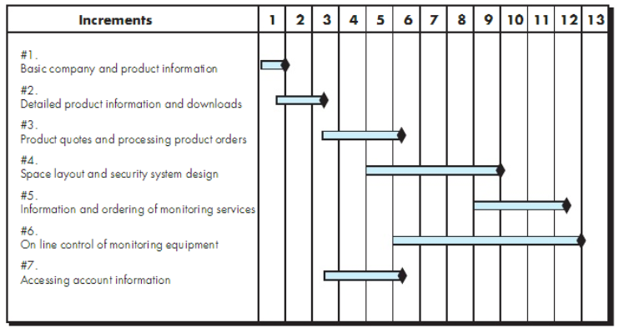
Macroscopic Project Schedule

Slide 29
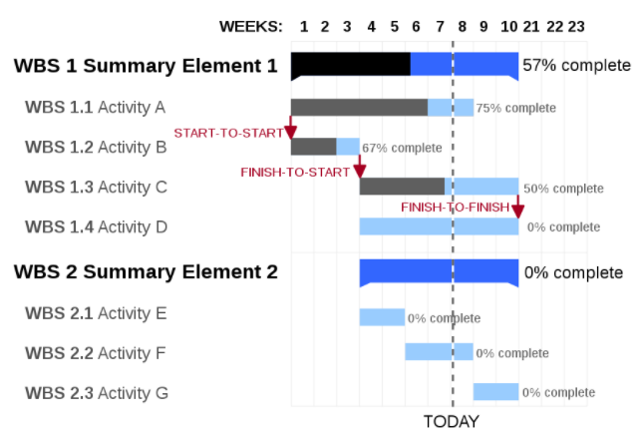
Gantt Chart (Contd.)
Source: https://www.workamajig.com/blog/gantt-charts-project-management

Slide 30
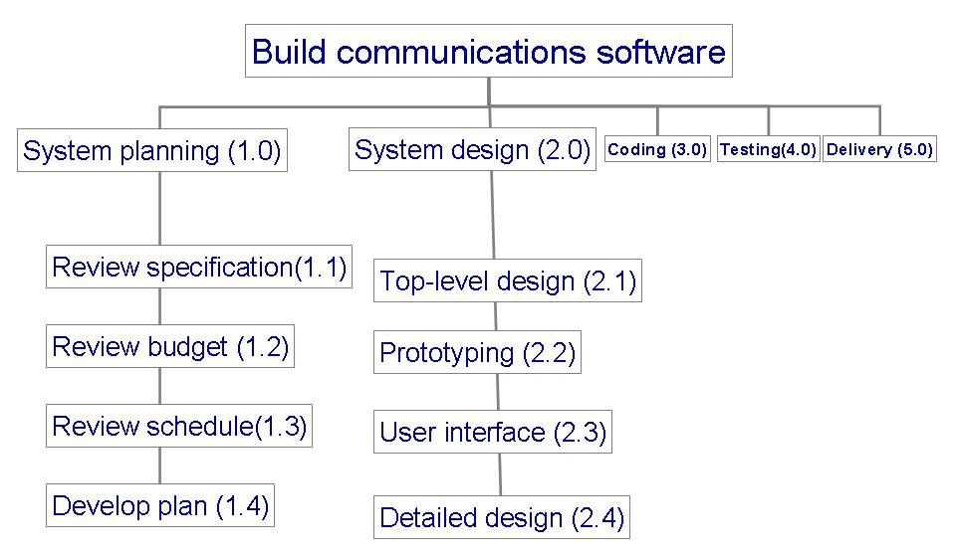
Example: to track progress of building a communication software
What is it?

Slide 31
References
Pfleeger SE Book
Pressman SE Book
Acknowledgement
A few slides have been reused from UCF slides for the SE course

